Slide 1

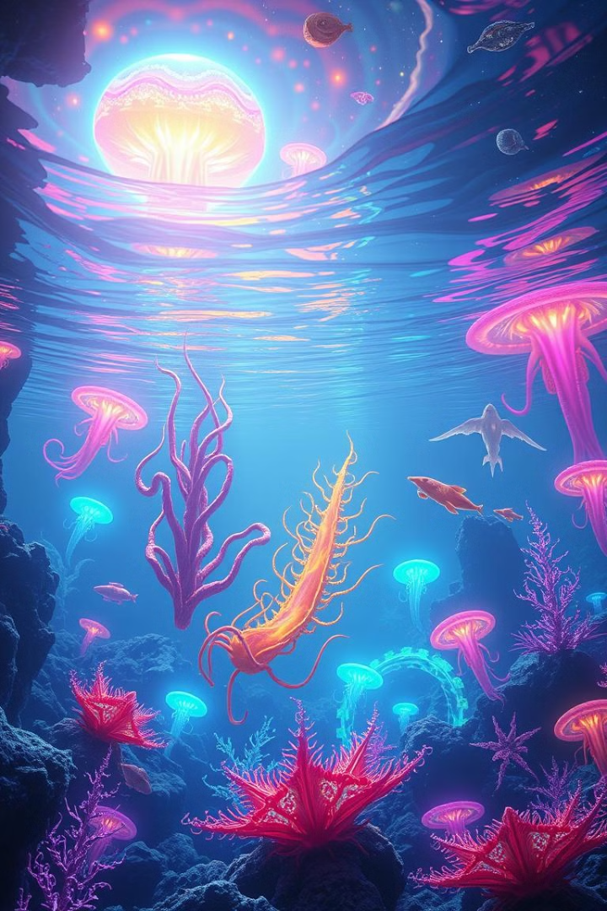
Ecosystems of an Ocean World: Chemosynthesis-Based Life
Imagine a world hidden beneath the surface of an icy moon, where sunlight never reaches, and life thrives in a unique way. This presentation explores the fascinating concept of chemosynthesis, a process that sustains life in the absence of sunlight. We'll delve into the conditions, habitats, and diverse lifeforms that could exist on such an ocean world, ultimately understanding the implications for astrobiology and the search for extraterrestrial life.
Notes:
1

Slide 2
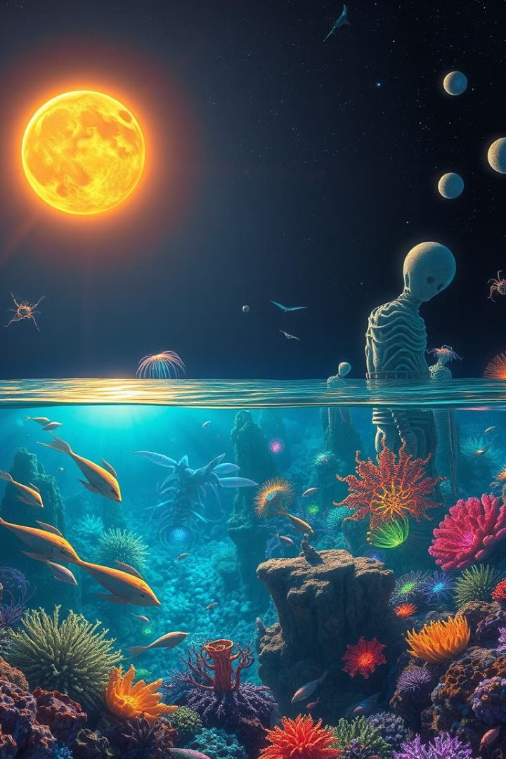

Astrobiology Beyond Earth-like Conditions
Expanding Our Search
Beyond the Familiar
Astrobiology, the study of life in the universe, traditionally focuses on Earth-like conditions. However, recent discoveries have broadened our understanding of what constitutes a habitable world.
Exploring ocean worlds, icy moons, and even planets within other solar systems, opens up new possibilities for the existence of life.
Alternative Energy Sources
These environments often lack sunlight but can host life sustained by alternative energy sources like chemosynthesis.
Notes:
2

Slide 3
What is Chemosynthesis?
Chemosynthesis
Photosynthesis
A process where organisms use energy from inorganic chemical compounds, like hydrogen sulfide or methane, to produce organic matter.
A process where organisms use sunlight as an energy source to convert carbon dioxide and water into organic compounds.
These organisms are often found in environments lacking sunlight, like deep-sea hydrothermal vents.
Photosynthesis is the dominant form of energy production on Earth, forming the basis for most ecosystems.
Notes:
3

Slide 4
Chemosynthesis vs. Photosynthesis
Chemosynthesis
Photosynthesis
Organisms use energy from inorganic chemical compounds, like hydrogen sulfide or methane, to produce organic matter. These organisms are often found in environments lacking sunlight, like deep-sea hydrothermal vents.
Organisms use sunlight as an energy source to convert carbon dioxide and water into organic compounds. Photosynthesis is the dominant form of energy production on Earth, forming the basis for most ecosystems.
Notes:
4

Slide 5

Conditions for Chemosynthetic Life
Energy Source
Chemical Gradient
Chemosynthetic organisms rely on inorganic chemical compounds, like hydrogen sulfide or methane, as their primary energy source.
A difference in chemical concentration is required to drive chemosynthetic reactions, often found near hydrothermal vents or other geological features releasing chemicals.
Water
Suitable Temperature
Chemosynthesis, like all biological processes, requires water as a solvent and medium for chemical reactions.
Chemosynthetic organisms have adapted to survive in a range of temperatures, some thriving near vents with extreme heat.
Notes:
5

Slide 6
Seafloor Hydrothermal Vents
Hot Springs of the Deep
Life-Sustaining Oasis
Hydrothermal vents are cracks in the ocean floor where geothermally heated water is released. This water is rich in dissolved minerals, including hydrogen sulfide and methane.
Hydrothermal vents provide a unique energy source for chemosynthetic organisms. They create a localized ecosystem teeming with life, even in the absence of sunlight.
These vents are found near areas of volcanic activity, typically along mid-ocean ridges or near subduction zones.
The vent environment is extreme, with high temperatures, pressure, and chemical concentrations, but these conditions have shaped the unique adaptations of the organisms that inhabit these regions.
Notes:
6

Slide 7
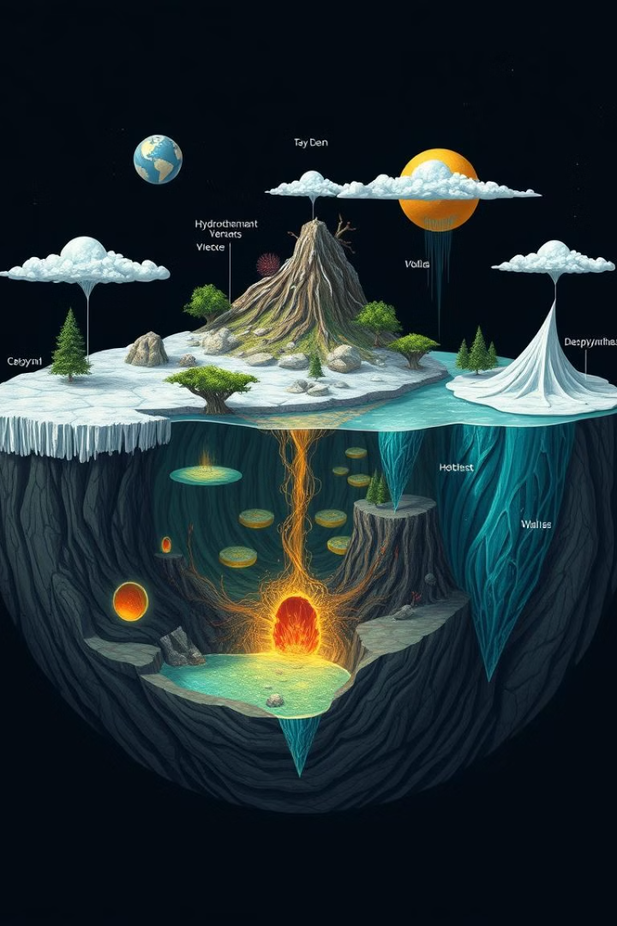
Potential Habitats on Ocean Worlds
1
Hydrothermal Vents
These are volcanic openings on the ocean floor that release geothermally heated water rich in minerals, providing an energy source for chemosynthetic life.
2
Icy Surfaces
Ocean worlds may have icy surfaces that are potentially habitable, with liquid water beneath the ice, and potential for life to exist in subglacial environments.
3
Deep-Ocean Trenches
These are the deepest parts of the ocean, potentially harboring unique ecosystems with chemosynthetic organisms, adapted to extreme pressure and lack of sunlight.
Notes:
7

Slide 8





Designing Chemosynthetic Ecosystems
Energy Source
1
Identify primary energy sources like hydrothermal vents or methane seeps.
2
Primary Producers
Design chemosynthetic organisms to capture energy from the source.
3
Food Webs
Introduce diverse consumers to create a balanced ecosystem.
4
Symbiotic Relationships
Explore mutualistic interactions between organisms for mutual benefit.
5
Adaptation and Evolution
Allow for natural selection and adaptations to optimize the ecosystem.
Notes:
8

Slide 9
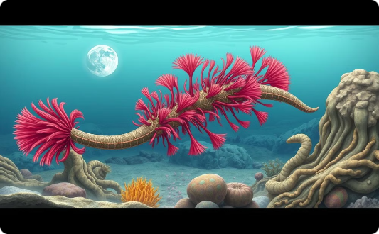
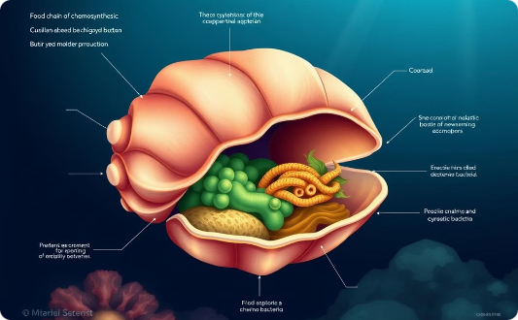
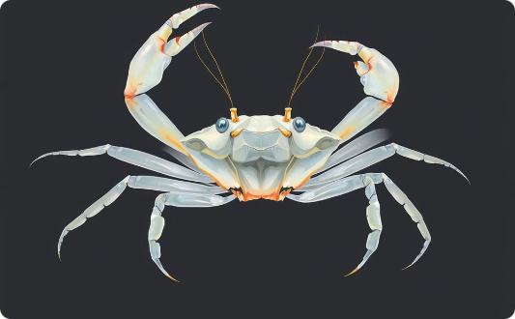
Diverse Lifeforms and Adaptations
Tube Worms
Deep-Sea Clams
Blind Crabs
These iconic creatures lack mouths and digestive systems, relying on symbiotic bacteria within their bodies to extract energy from chemicals in the vent fluid.
These clams host symbiotic bacteria in their gills, which convert hydrogen sulfide into energy, supporting the clam's growth.
These crabs have adapted to the dark depths, with reduced eyesight and sensitive antennae to navigate their surroundings.
Notes:
9

Slide 10
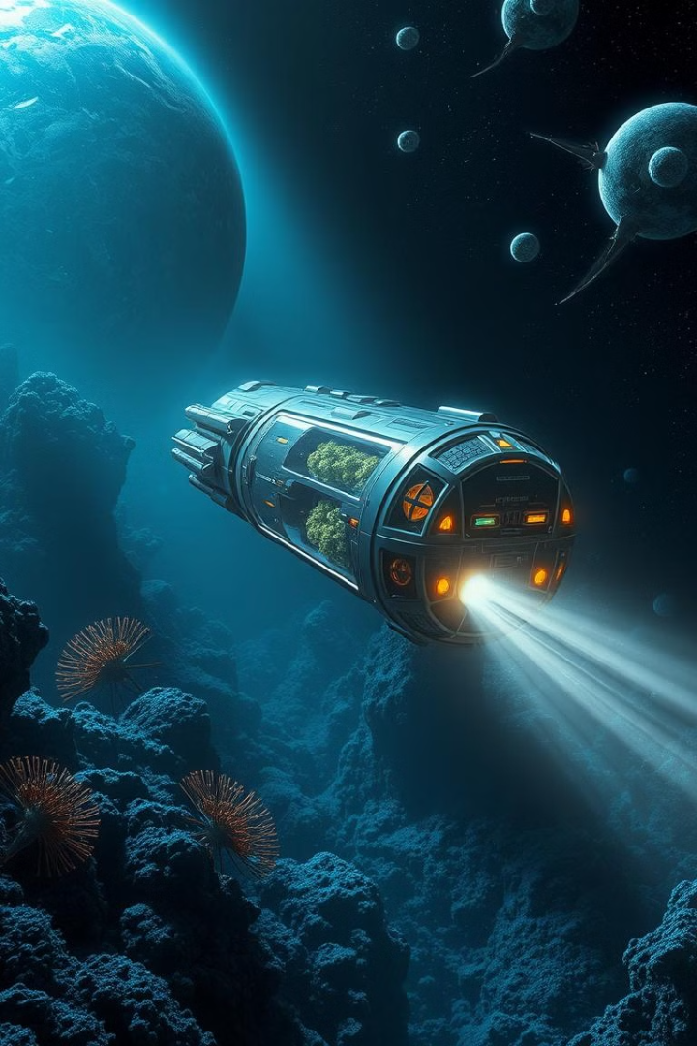




Implications for Astrobiology and Exploration
Expanding the Search for Life
The discovery of chemosynthetic life expands the potential for life beyond Earth, demonstrating that life can thrive in environments previously considered uninhabitable.
New Targets for Exploration
Ocean worlds like Europa and Enceladus become more attractive targets for future missions, as they potentially harbor chemosynthetic ecosystems.
Understanding Life's Diversity
Studying chemosynthetic life provides insights into the diversity of life and its potential for adaptation to extreme conditions.
Future of Astrobiology
This research fuels the future of astrobiology, prompting new investigations and technological advancements to explore these alien worlds.
Notes:
10

